Slide 1
TOPIC 5
Door lock control

Slide 2
GROUP 1
Phạm Thanh Danh - 1852110
Hồ Anh Tài - 1810490
Lê Trần Minh Đức - 1852136
Trần Nhựt Quang - 1852073

Slide 3
Analyzing problem
1.Problems
-Implement a Door lock mechanism using FSM, featuring the following requirements:
+ Password.
+ Set mode.
+ Verify mode.
+ Block mode.
+ Reset button.

Slide 4
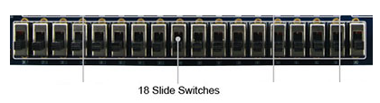

2.Basic Functions:
+ Password:
-Three numeric digits from 0 to 9.
Ex:
321; 123; 453 : Correct
1234; 98213; 12; 21; 1 : Incorrect
-Digits are input by BCD code.
Ex: Some BCD code
*Packed BCD:
Decimal : 9 1
Binary : 1001 0001
-Using SWs to generate the input signals.
Ex :
-Inputs have to be showed on the 7-segments LED after confirmed by using the KEY0.

Slide 5
+Set mode:
***Main function : For the users to set the passwords.
Ex: Decimal : 123 BCD code : 0001 0010 0011
-Passwords must follow the previous requirements.
Ex:
All check.
-Passwords will be updated after the last no.3 digits is puted in and confirmed the mode is switch to Verify.

Slide 6

+ Verify mode:
***Main function :
For users to input passwords and the system to check it ( unlock the system). // Note: 123 or 0001 0010 0011 is the passwords
++Correct passwords:
-Green LED light will blink, with the 5Hz frequency.
++Incorrect passwords:
*Notice: Each user has 3 trials.
-First trials : Red LED blink, frequency : 1 Hz.
-Other trials: If the user input a correct passwords, the system will be unlock and the number
of trials reset to 1. If not, the Red LED will blink as previous until final trials and block the system.

Slide 7
+Block mode:
-After 3 continuous failed attempts to input the passwords, the system will be blocked.
-Can only be unlocked using Reset Button.

Slide 8
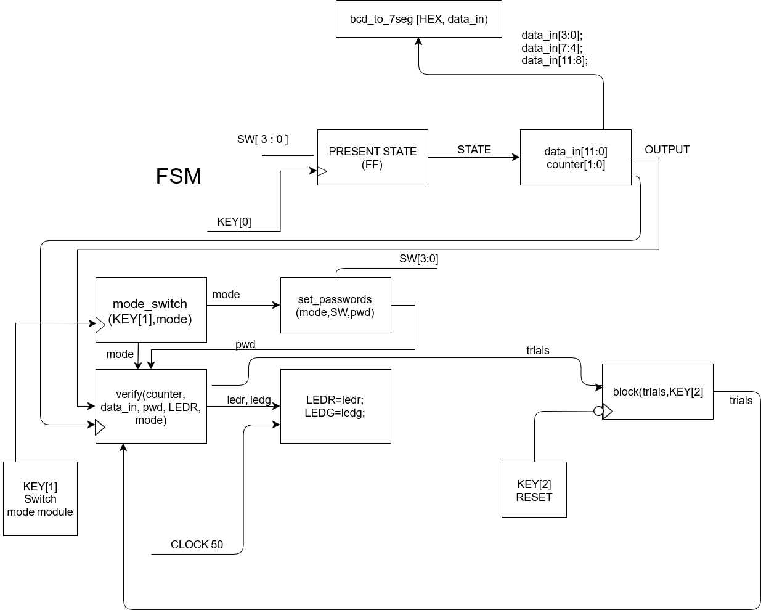

Slide 9
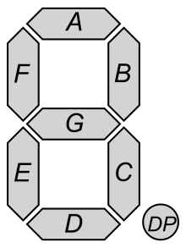
BCD to HEX:
Input: data_in (4 bits ) = SW[3:0]
Output: data_out (7 bits)
A
B
C
D
E
F
G
Switchs [3:0] is used to input every single number of the passwords
Display input on 7 segments
SW3 SW2 SW1 SW0

Slide 10
COUNT MODULE
Base on D Flip-Flop:
count variable run from 0 -2 and turn back to 0 when reach 2
Present state |  | Next state |  | Control Inputs
B | A | B | A | Db | Da
0 | 0 | 0 | 1 | 0 | 1
0 | 1 | 1 | 0 | 1 | 0
1 | 0 | 0 | 0 | 0 | 0
1 | 1 | 0 | 0 | 0 | 0

Slide 11
 | A’ | A
B’ | 1 | 0
B | 0 | 0
 | A’ | A
B’ | 0 | 1
B | 0 | 0
Da = A’B’
Db = AB’

Slide 12
Fsm_pwdinput
count
2’b01
Data_t1 = pwd_current
Data_t2 = 4’b1111
Data_t3 = 4’b1111
Clock3 = 1’b0
Cont variable continuously count from 0 to 2
Press KEY[0]
Pwd_current <= pwd_next
(pwd_current change)
Pwd_next take the value of user’s input from switch
2’b10
Data_t1 = Data_t1
Data_t2 = pwd_current
Data_t3 = 4’b1111
Clock3 = 1’b0
Clock3 = 1’b1
User input binary number from SW
Clock3 = 1’b0
Default
Pwd_next = 4’b1111
2’b00
Data_t1 = Data_t1
Data_t2 = Data_t2
Data_t3 = pwd_current
Clock3 = 1’b1
Default
All variables stay the same (no change)

Slide 13
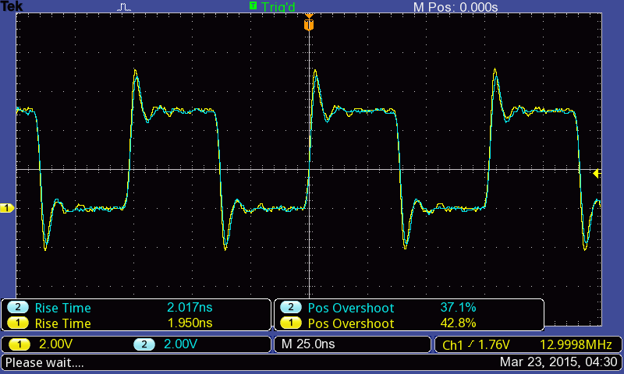
DEBOUNCE_DISPLAY
Raw clock
DEBOUNCE_DISPLAY
signal

Slide 14
User
Count < 20_001_000
Release KEY
default
Signal = 1’b0
Press a KEY
default
Count = count + 1
Count = 26’d0
Signal = 1’b1
Count = count
Signal = signal
Signal = 1’b0
Count = 26’d0
Signal = signal
signal
1s

Slide 15
SET PASSWORDS
Mode = 1b’0
Clock3
Set_password
Password = data_in
enable = 1b’0

Slide 16
MODE_SWITCH
Mode = 1’b0
Mode = 1’b1
SET MODE
VERIFY MODE

Slide 17
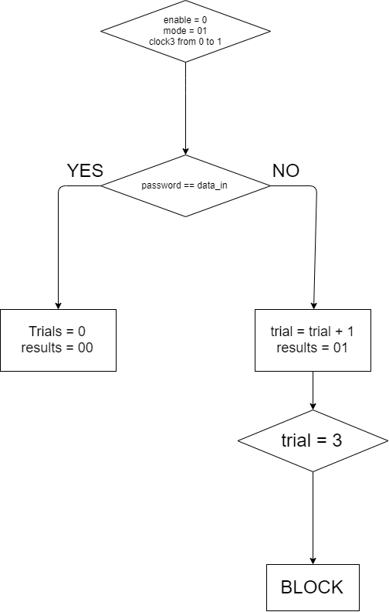
VERIFY MODE

Slide 18
THANK YOU FOR LISTENING

